Slide 1
Positive rate of change from a graph
Graphical representations of linear equations

Slide 2
how to use Oak lessons

Slide 3
I can calculate the positive rate of change (gradient) from a graph.

Slide 4
The rate of change is how one variable changes with respect to another. If the change is constant, there is a linear relationship between the variables.
The gradient is a measure of how steep a line is. It is calculated by finding the rate of change in the y-direction with respect to the positive x-direction.

Slide 5

Positive rate of change from a graph
Defining gradient
Calculating positive gradients from graphs

Slide 6
Defining gradient
Here are the beginnings of some students’ staircase patterns:
Andeep
Izzy
Jun
Laura
Whose pattern will reach the top of the page first?
Jun’s pattern will reach the top first. It goes right 1 square and up 2 squares.
His staircase is steepest.
Whose pattern do you think will reach the top of the page second?
Andeep’s and Laura’s will reach the top of the page at the same time.
His goes right 1 up 1 and hers goes right 2 up 2. The overall movement is the same.

Slide 7
Defining gradient
Andeep
Izzy
Jun
Laura
What assumptions have you made?
E.g. Their pieces of paper are all the same height.
Their staircases carry on in the same pattern.
They all reach the top of the page before running out of width.
We can describe the steepness of these staircases by looking at the number of squares moved in a horizontal and vertical direction.
E.g. Izzy’s staircase moves 2 squares right then 1 up.

Slide 8
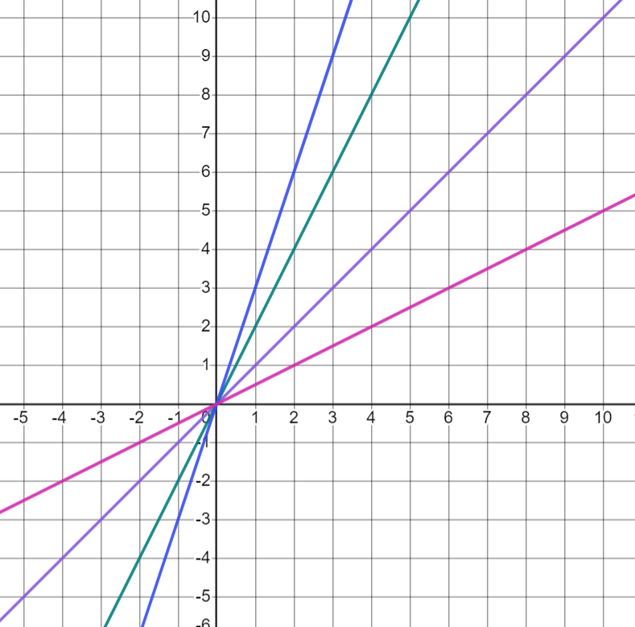
Defining gradient
Aisha has plotted the linear relationships below.
What is the same and what is different about her four graphs?
Similarities
All her graphs are straight lines.
They all pass through the origin.
As the x-values increase so do the y-values (graphs go from bottom left to top right.)
Differences
They have different steepnesses/ rates of change.
They rise at a different rate.

Slide 9

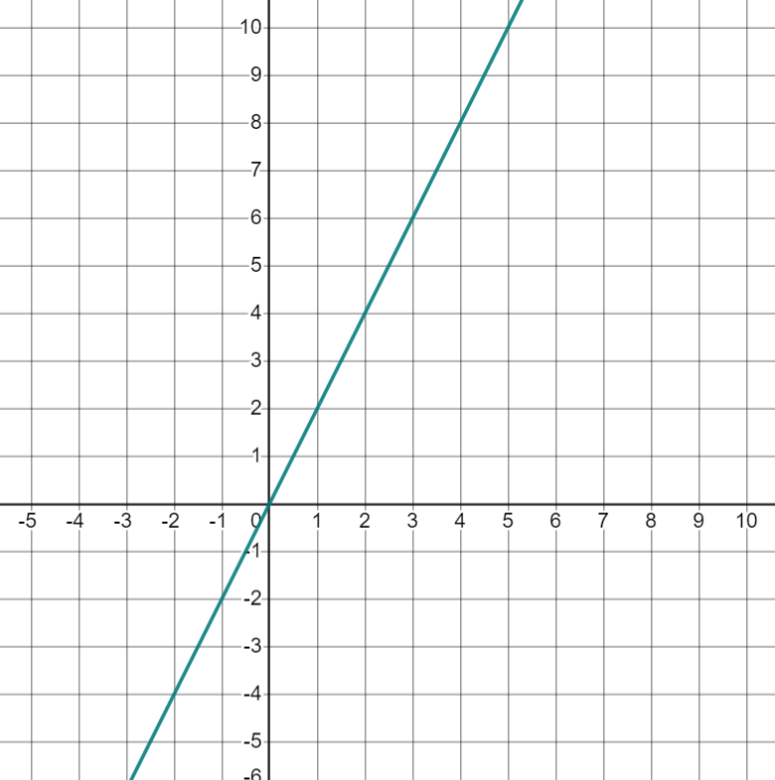



Defining gradient
Aisha’s classmates try to describe the rate of change for the green graph below.
The graph goes 1 across and 2 up
The graph moves 1 in the x-direction and 2 in the y-direction
Andeep
Izzy
For every 1 square in the positive x-direction, the graph rises 2 in the positive y-direction
Whose description do you think is the best and why?
Jun

Slide 10
Defining gradient
For every 1 square in the positive x-direction, the graph rises 2 in the positive y-direction
Jun
Jun has made it clear which direction he is referring to.
He has described the rise as a rate of change.

Slide 11
Defining gradient
It is useful to refer to the rate of change in all graphs in a similar way.
We can refer to the rate of change in all graphs as the amount y changes when x increases by 1.
We call this measure of rate of change, the gradient.

Slide 12
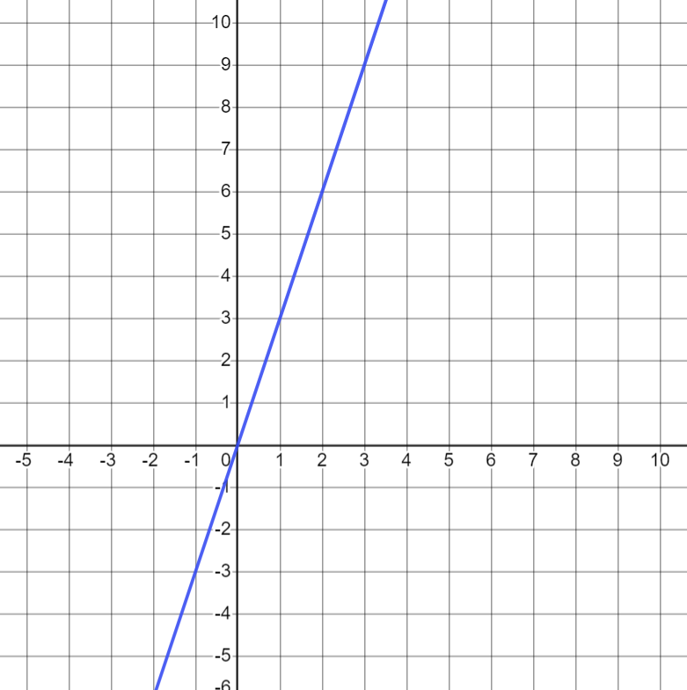
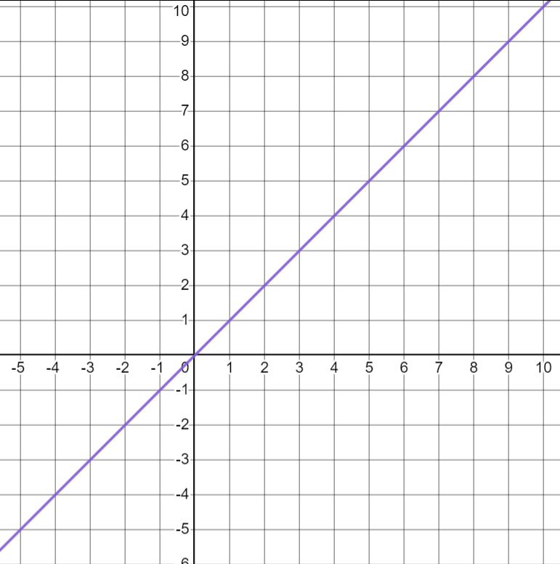
Defining gradient
The gradient of this line is 3 because for every 1 square moved in the positive x-direction, the graph increases by 3 in the y-direction.
The gradient of this line is 1 because for every 1 square moved in the positive x-direction, the graph increases by 1 in the y-direction.

Slide 13
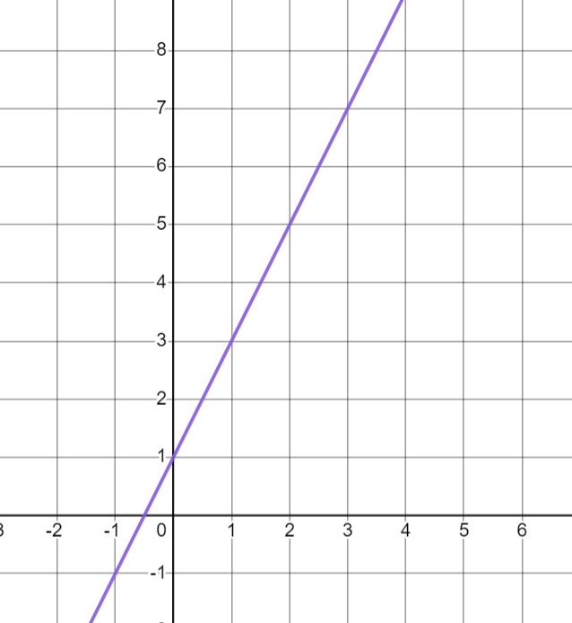


Defining gradient
Which of these describe the gradient of this line?
For every 2 in the positive x-direction the graph increases by 1 in the y-direction.
a
The graph increases by 2 in the y-direction for every 1 increase in the x-direction.
b
c
For every 1 in the positive y-direction the graph changes by 0.5 in the positive x-direction.
d
The graph rises by 4 in the y-direction for every 2 in the x-direction.

Slide 14
Defining gradient
Graphs have a positive gradient if as x increases, y also increases.
All these graphs have positive gradient because y increases as the graph moves to the right (positive x-direction)

Slide 15
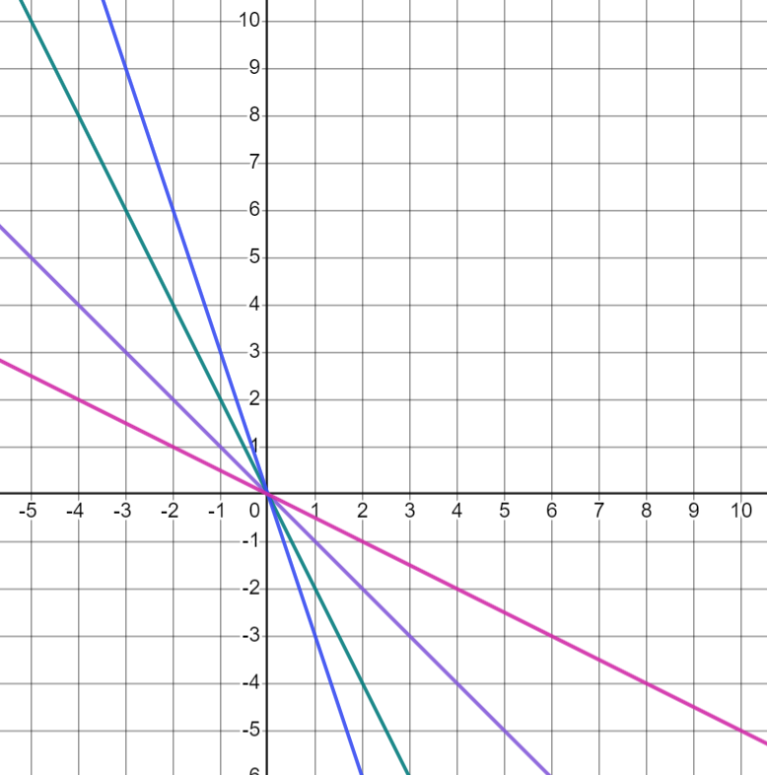
Defining gradient
Graphs have a positive gradient if as x increases, y also increases.
These graphs do not have positive gradient because y decreases as the graph moves to the right (positive x-direction)

Slide 16
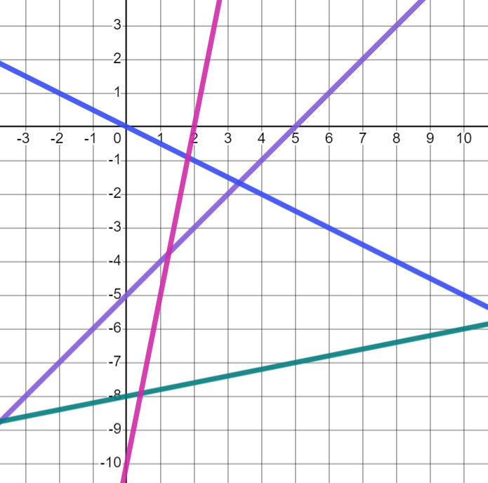
Defining gradient
Which of these graphs have a positive gradient?
A
B
A- pink graph
B- purple graph
C
D- green graph
D
C- the blue graph does not have a positive gradient because y decreases as the graph moves to the right.

Slide 17

Defining gradient
We can sometimes see the gradient represented in a table of values if the x-values increase by 1
+1
+1
+1
+1
x | −2 | −1 | 0 | 1 | 2
y | 5 | 7 | 9 | 11 | 13
As x increases by 1, y increases by 2 so the gradient is 2
+2
+2
+2
+2
+1
+1
+1
+1
x | 7 | 8 | 9 | 10 | 11
y | 5 | 9 | 13 | 17 | 21
As x increases by 1, y increases by 4 so the gradient is 4
+4
+4
+4
+4

Slide 18

Defining gradient
+2
+1
+1
+3
The graph of these points has different gradients at different points.
x | −2 | 0 | 1 | 2 | 5
y | 1 | 3 | 4 | 5 | 8
+2
+1
+1
+3
Aisha
Where has Aisha gone wrong?
Gradient describes the change in y for every 1 increase in x. Aisha’s x values do not all increase by 1 each time.

Slide 19
Defining gradient
The gradient of the line made by plotting these points is 2
x | 0 | 2 | 4
y | 5 | 7 | 9
The x-values do not increase by 1
The y-values increase by 2

Slide 20
Defining gradient
a) Starting with the steepest, put these steps in order.
C
G
A
E
B
D
F
H
b) Draw staircase H so it is the steepest staircase.
× Q
c) Another set of steps join point P to point Q. Where would these steps go in your order of steepness?
× P

Slide 21
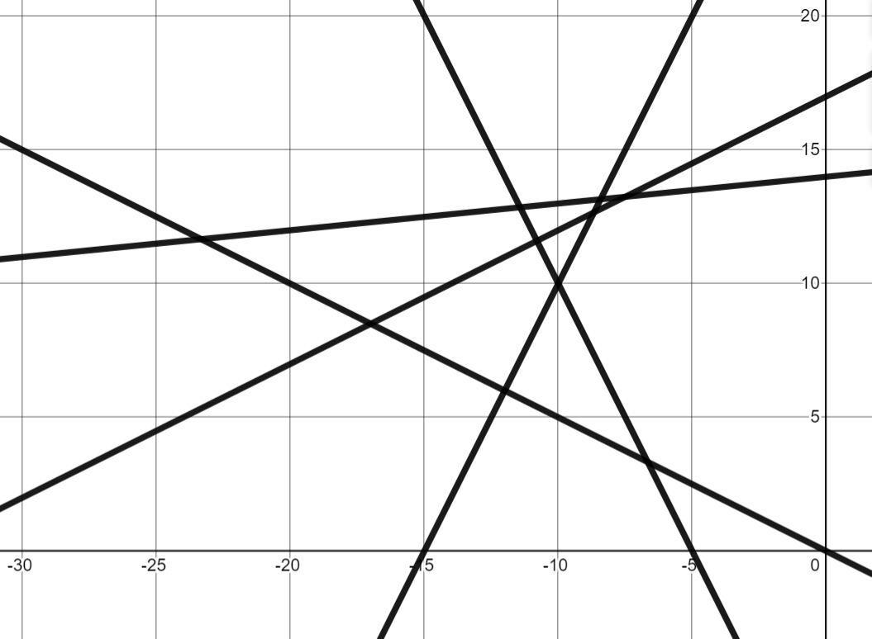
Defining gradient
2) Which lines have a positive gradient?
3) Which tables of values show a relationship which will have positive gradient when plotted?
D
E
x | 0 | 1 | 2 | 3
y | 3 | 5 | 7 | 9
C
a)
b)
c)
B
x | −2 | −1 | 0 | 1
y | 12 | 8 | 4 | 0
A
x | −8 | −7 | −6 | −5
y | −8 | −5 | −2 | 1

Slide 22
Defining gradient
a) Starting with the steepest, put these steps in order.
steepest: E - B - A - F - C - G - D least steep
C
G
A
E
B
D
F
H
E.g.
b) Draw staircase H so it is the steepest staircase.
× Q
c) Another set of steps join point P to point Q. Where would these steps go in order of steepness?
× P
Same as A

Slide 23
Defining gradient
2) Which lines have a positive gradient?
3) Which tables of values show a relationship which will have positive gradient when plotted?
D
E
x | 0 | 1 | 2 | 3
y | 3 | 5 | 7 | 9
C
a)
b)
c)
Positive, y increases as x increases
B
x | −2 | −1 | 0 | 1
y | 12 | 8 | 4 | 0
Not positive, y decreases as x increases
A
x | −8 | −7 | −6 | −5
y | −8 | −5 | −2 | 1
A, B and E have positive gradients
Positive, y increases as x increases

Slide 24
Positive rate of change from a graph
Defining gradient
Calculating positive gradients from graphs

Slide 25
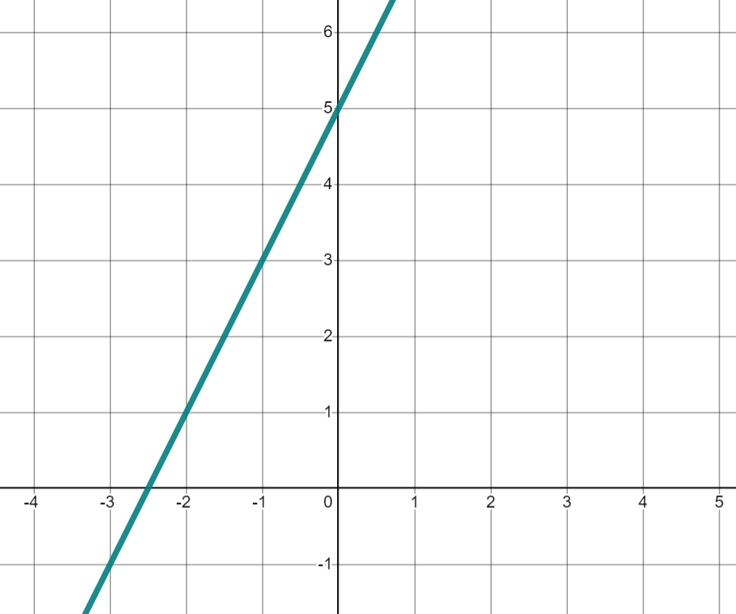
Calculating positive gradients from graphs
We can calculate the gradient from any graph.
Pick a point on the line.
Draw an arrow to show a step of 1 in the positive x-direction.
×
+2
×
Draw an arrow vertically until you reach the line again.
+1
Change in x | Change in y
1 | 2
This graph has a gradient of 2 because y increases by 2 when x increases by 1

Slide 26
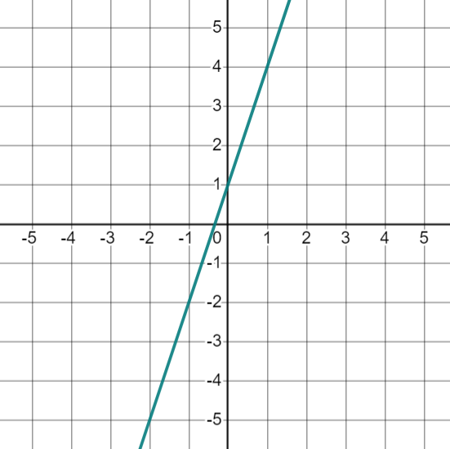
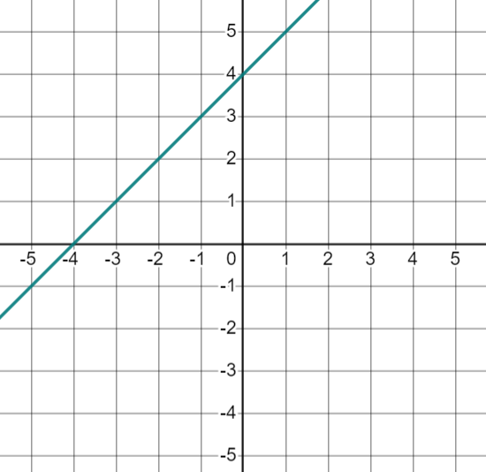
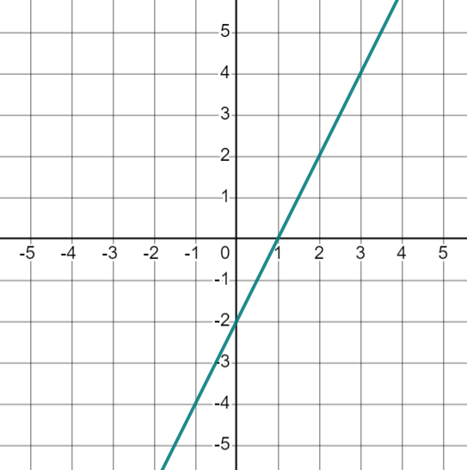
Calculating positive gradients from graphs
Match the graphs to the correct gradients.
gradient: 1
gradient: 2
gradient: 3

Slide 27
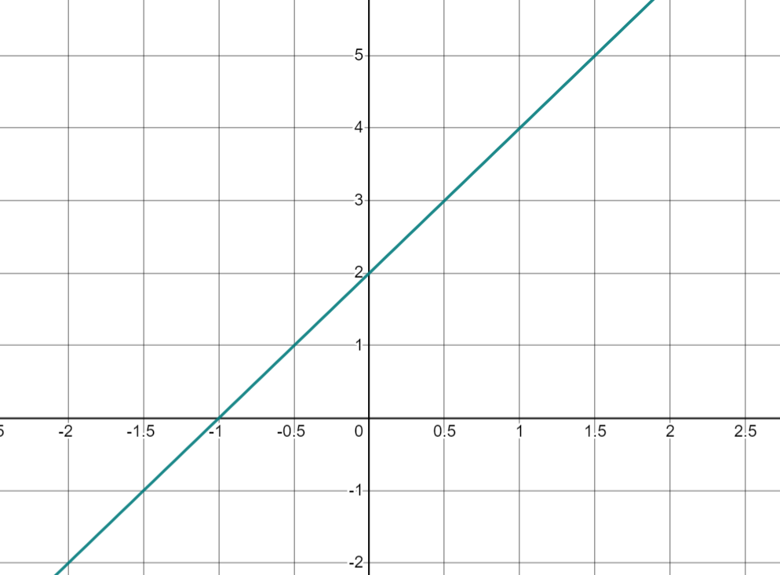
Calculating positive gradients from graphs
Gradient describes the change in y for an increase of 1 in the positive x direction.
We need to read the scales on our axis carefully to label an increase of 1 in the positive x-direction correctly.
What do you notice about the scales on these axis?
The x axis has a step of 0.5

Slide 28
Calculating positive gradients from graphs
Let’s find the gradient:
×
Pick any integer point.
+2
×
Draw an arrow to show a step of 1 in the positive x-direction.
+1
Draw a vertical arrow until you reach the line again.
This graph has a gradient of 2 because y increases by 2 when x increases by 1
Change in x | Change in y
1 | 2

Slide 29
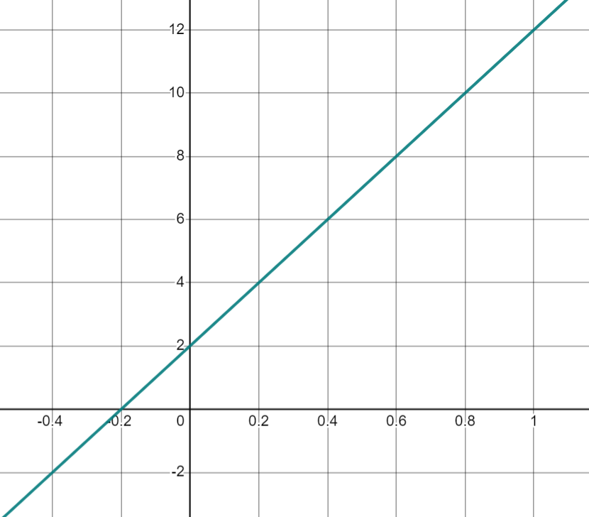
Calculating positive gradients from graphs
Jun has tried to calculate the gradient of this line.
Identify his mistakes. What advice would you give him?
The gradient is 1
+1
Jun
+1
E.g. He needs to look at the scale on the x-axis and move across 1, not 1 square.
He needs to look at the scale on the y-axis and see how much the y-values have increased, not just count the squares.

Slide 30
Calculating positive gradients from graphs
Jun has tried to calculate the gradient of this line.
Identify his mistakes. What advice would you give him?
+10
Thanks, so the gradient is actually 10
+1
Jun
Change in x | Change in y
1 | 10

Slide 31
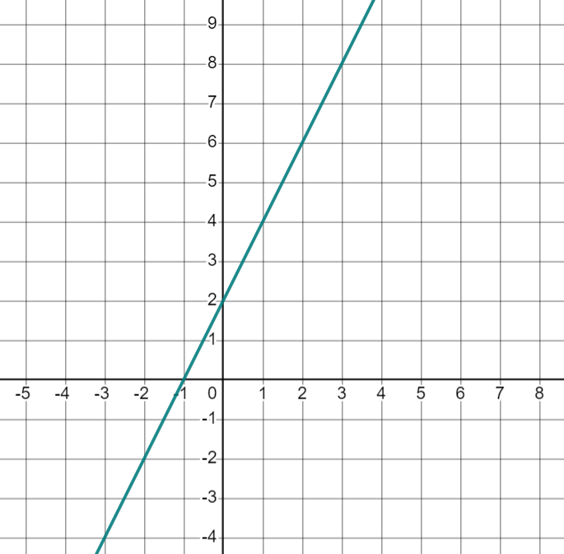
Calculating positive gradients from graphs
Izzy is calculating the gradient of this line.
×
The squares representing a step of 1 are quite small so she has drawn her arrows like this:
+6
×
+3
Can she still calculate the gradient?
Change in x | Change in y
3 | 6
÷3
÷3
1
2
What can we do to these values so they show the change in y for an increase of 1 in x?

Slide 32
Calculating positive gradients from graphs
Change in x | Change in y
3 | 6
1
×
÷3
÷3
+6
2
× 2
×
+3
This line has a gradient of 2
This is a ratio table.
You can either divide the values so the change in x becomes 1
Or you can look at the relationship between the changes in x and y

Slide 33
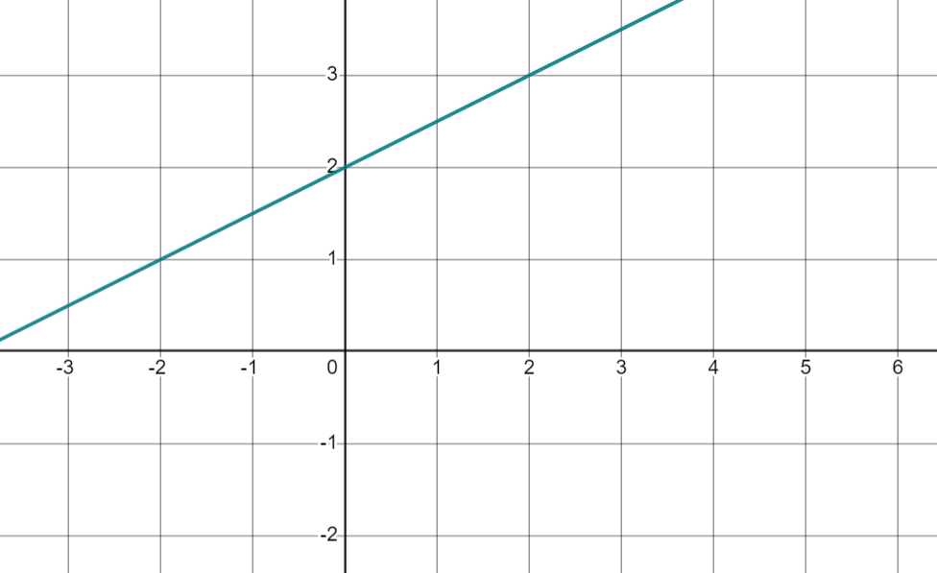
Calculating positive gradients from graphs
Using ratio tables can be really useful when the gradient is a non-integer value.
Looking at an increase of 1 in the x-direction gives a non-integer value.
+1
Without more grid lines, it is hard to see the exact amount y has increased by.

Slide 34

Calculating positive gradients from graphs
Instead we could look at an increase of 2 in the x-direction
Change in x | Change in y
2 | 1
+1
÷2
÷2
+2
1
Then we can divide both values to see the change in y for an increase of 1 in x
This line has a gradient of , fractions are often easier to work with than decimals so where possible, write your gradient as a fraction.

Slide 35


Calculating positive gradients from graphs
Fill in the gradient of each line in each ratio table.
Change in x | Change in y
5 | 5
1
Change in x | Change in y
3 | 9
1
1
3
Change in x | Change in y
2 | 3
1
Change in x | Change in y
3 | 5
1

Slide 36
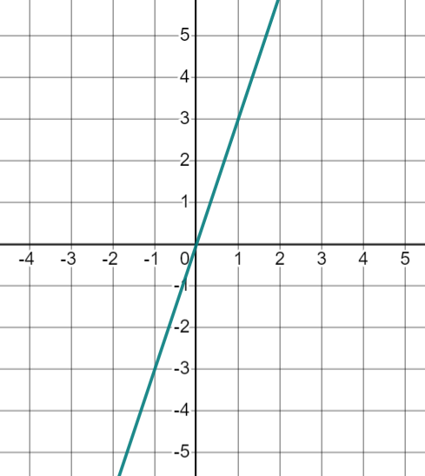
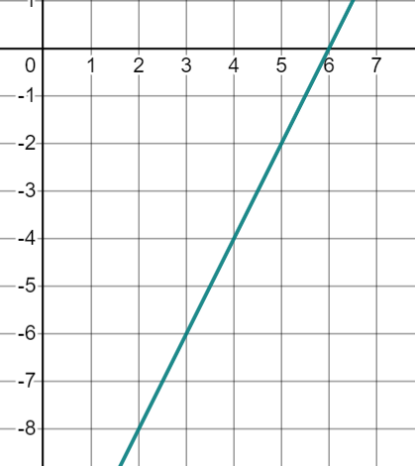
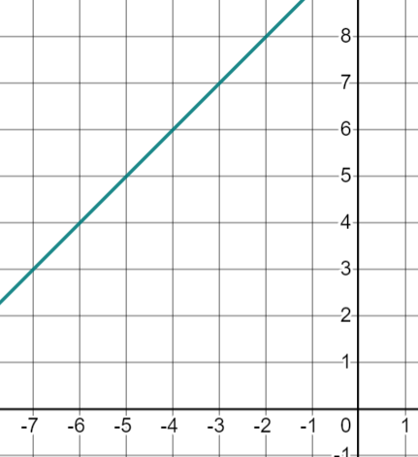
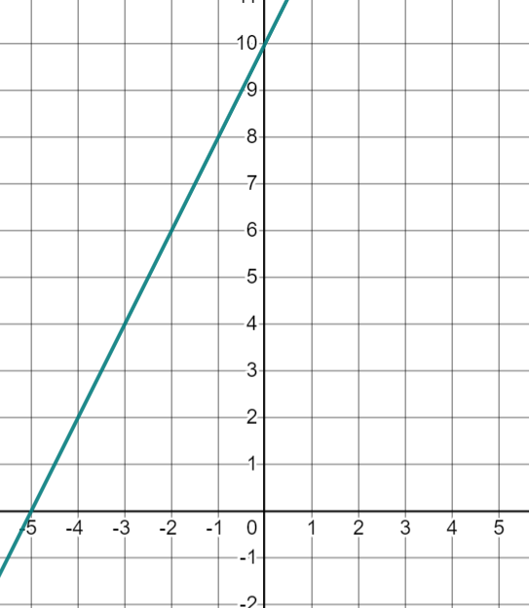
Calculating positive gradients from graphs
Find the gradient of each line. You can draw a ratio table to help you.
a) | b) | c) | d)

Slide 37
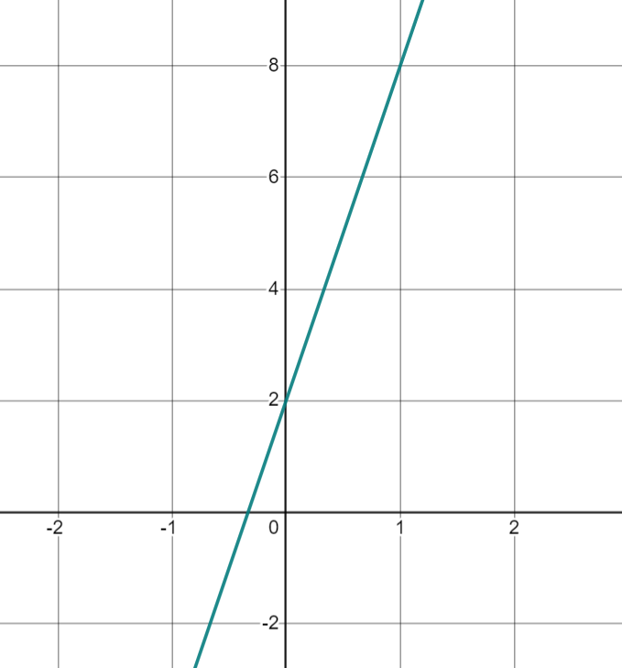
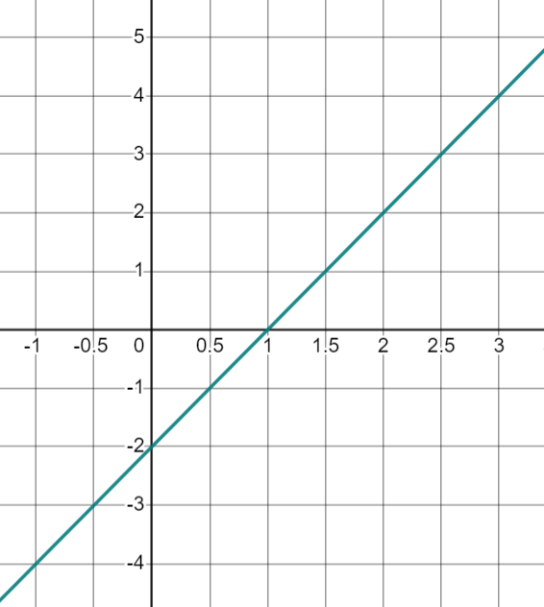
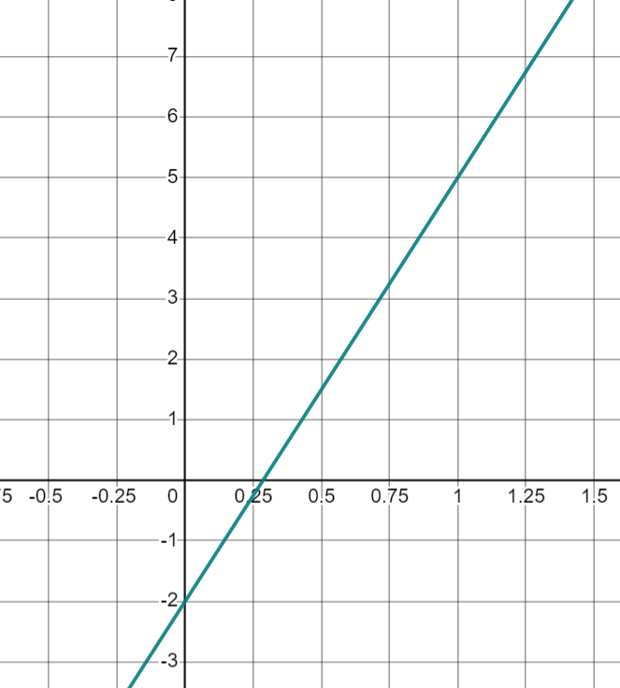
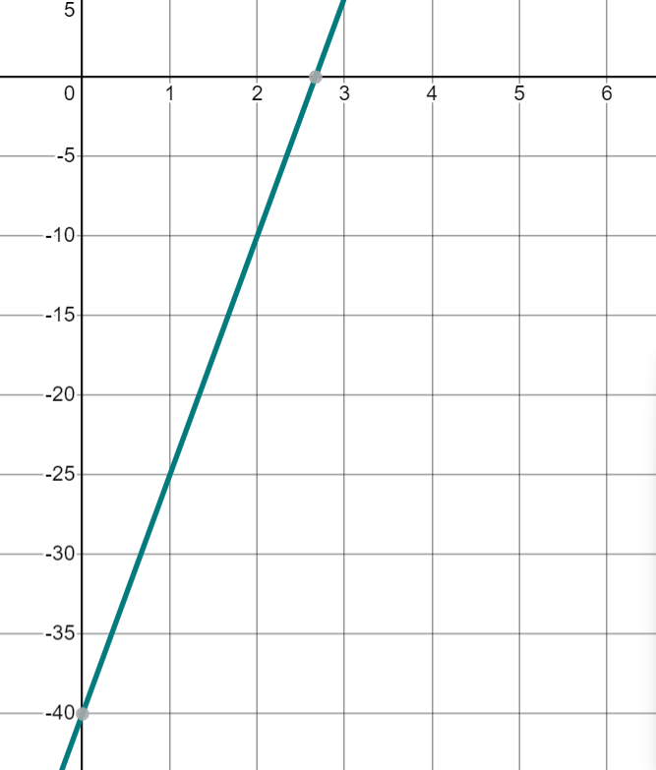
Calculating positive gradients from graphs
Find the gradient of each line. You can draw a ratio table to help you.
e) | f) | g) | h)

Slide 38
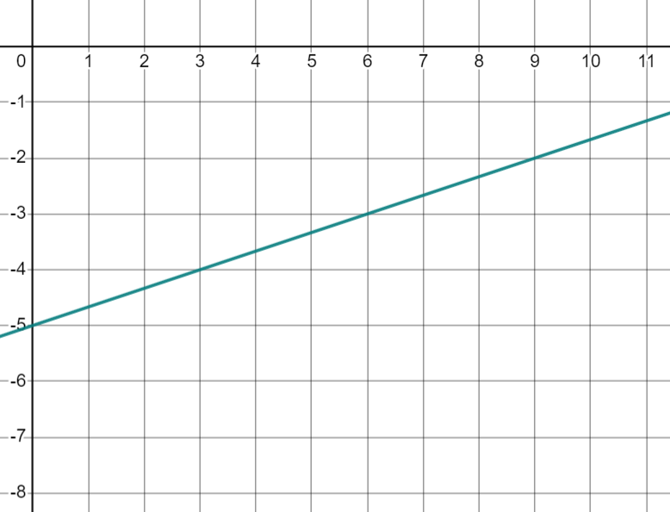
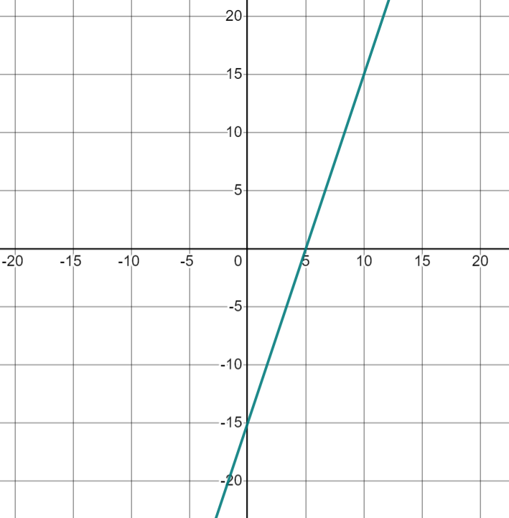
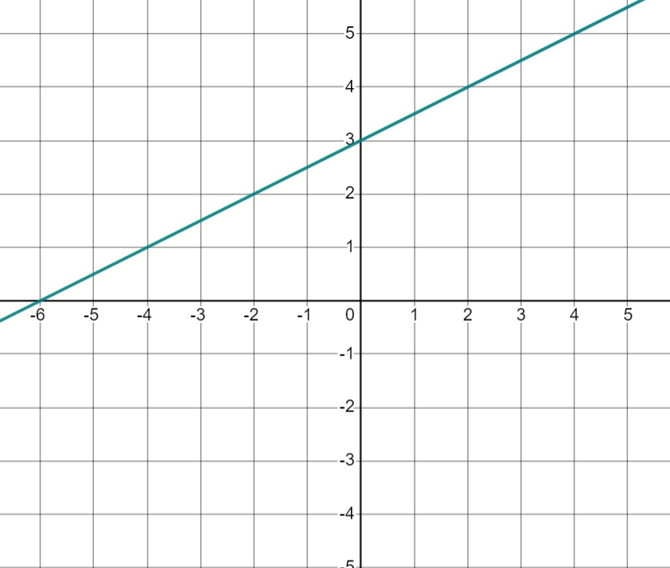
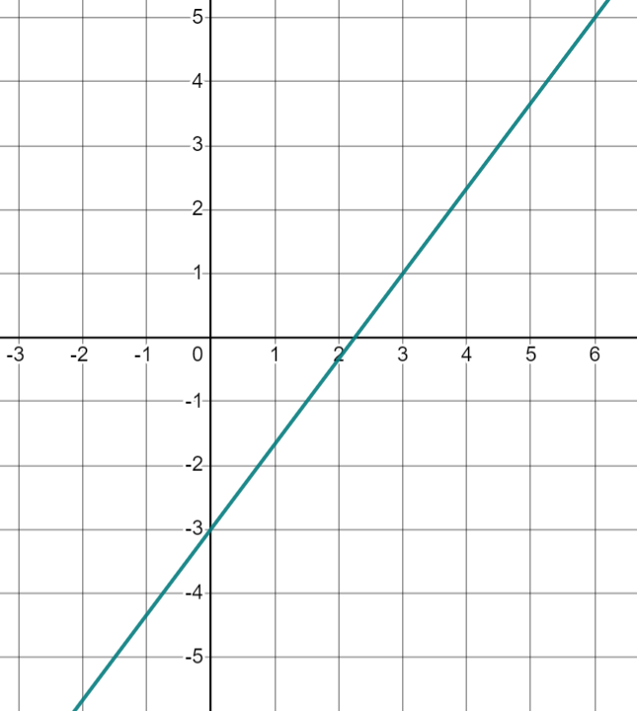
Calculating positive gradients from graphs
Find the gradient of each line. You can draw a ratio table to help you.
i) | j) | k) | l)

Slide 39
Calculating positive gradients from graphs
Find the gradient of each line. You can draw a ratio table to help you.
a) | b) | c) | d)
3
2
1
2

Slide 40
Calculating positive gradients from graphs
Find the gradient of each line. You can draw a ratio table to help you.
e) | f)
Change in x | Change in y
0.5 | 1
1 | 2
6
2

Slide 41
Calculating positive gradients from graphs
Find the gradient of each line. You can draw a ratio table to help you.
g) |  | h)
7
15

Slide 42


Calculating positive gradients from graphs
Find the gradient of each line. You can draw a ratio table to help you.
i) | j) | k) | l)
2 | 1
1
3 | 1
1
5 | 15
1 | 3
3 | 4
1

Slide 43
Positive rate of change from a graph
Gradient measures the amount y changes when x increases by 1
If y increases as x increases, the gradient is positive.
The gradient can be found from any graph by considering the change in y for each increase of 1 in the positive x-direction.

Slide 44

© Oak National Academy 2023.
Produced in partnership with Mathematics in Education and Industry.
Licensed on the Open Government Licence v3.0, except where otherwise stated. See Oak terms and conditions.

